Slide 1
Learn HTML
Basics and introduction to HTML

Slide 2
HTML home
*With HTML you can create your own Website.
*This tutorial teaches you everything about HTML
*HTML is easy to learn - You will enjoy it.

Slide 3
Example:-
<!DOCTYPE html>
<html>
<head>
<title>Page Title</title>
</head>
<body>
<h1>This is a Heading</h1>
<p>This is a paragraph.</p>
</body>
</html>

Slide 4
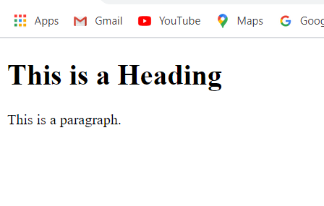
Output:

